Slide 1
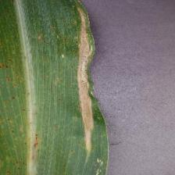
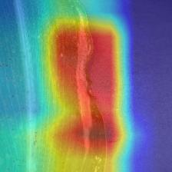
Leaf Disease Classification
Team name: Hello World !
Yi Ren (z5567992)
Haoyu Guo (z5568296)
Yi Chen (z5567828)
Dongbin Pu (z5580978)
Yixiao Wang (z5519041)

Slide 2
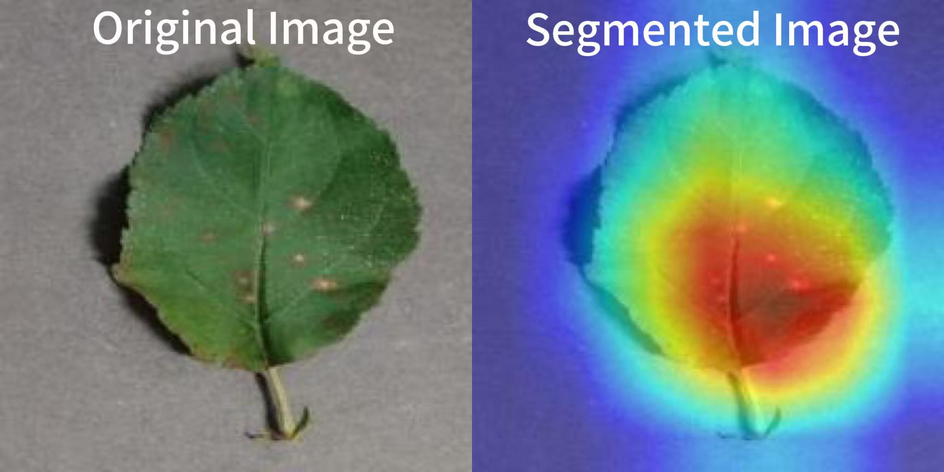
Motivation
Plant diseases threaten global food security and crop yields. Manual detection is slow, inefficient, and often inaccurate. Deep learning enables fast, efficient, and scalable disease detection. This project uses leaf image classification to distinguish healthy leaves from diseased leaves
Image Segmentation: Image classification uses a model to identify the category of an entire image, such as whether a leaf is healthy or diseased and its disease type.
One of the core tasks in computer vision
Broad array of applications:
Smart agriculture
Early disease detection
AI-powered Farm Management
Agriculture prediction and sustainability
Food Supply Optimization
…
Presenter: Yi Ren (z5567992)
Notes:
First, let me start with the motivation.
Plant diseases are a major threat to food security and crop yields worldwide. Traditional detection methods are slow, subjective, and labor-intensive. Our goal is to use deep learning to automate this process, making it faster and more accurate.
We focus on image classification, where the model identifies whether a leaf is healthy or diseased, and if diseased, what type of disease it has. This has many real-world applications in smart agriculture, early disease detection, and even optimizing food supply chains.

Slide 3
Problem Statement
Traditional plant disease identification relies heavily on manual detection, which is inefficient and easily affected by subjectivity.
In actual agricultural production, rapid and accurate disease identification is crucial to improving crop yield and quality.
Agricultural production requires a lightweight and efficient image classification model that can achieve high-accuracy identification with limited computing resources.
Project goal: Classify the corresponding plant disease type according to the leaf image.
Presenter: Yi Ren (z5567992)
Notes:
Next, the problem we’re solving is to build a lightweight but accurate classification model that can be used in real-world agricultural environments, where computing resources might be limited. So we aim to classify leaf diseases based only on images.

Slide 4
Literature Review
Ferentinos (2018) explored the use of deep CNN architectures, including VGG16 and AlexNet, for plant disease detection across 25 crop-disease combinations, achieving over 99% accuracy. This demonstrated the potential of deep learning for automated diagnosis in agriculture.
Sladojevic et al. (2016) implemented a deep neural network to classify plant diseases from leaf images using a CNN model trained on a relatively small dataset. Their work highlighted CNNs’ effectiveness even with limited data.
[1] Ferentinos, K.P., 2018. ‘Deep learning models for plant disease detection and diagnosis’, Computers and Electronics in Agriculture, 145, pp.311–318, accessed 24 July 2025, <https://www.sciencedirect.com/science/article/abs/pii/S0168169917311742>
[2] Sladojevic, S., Arsenovic, M., Anderla, A., Culibrk, D. and Stefanovic, D. (2016) ‘Deep neural networks based recognition of plant diseases by leaf image classification’, Computational Intelligence and Neuroscience, 2016, pp. 1–11, accessed 24 July2025, <https://onlinelibrary.wiley.com/doi/10.1155/2016/3289801>
Presenter: Yi Ren (z5567992)
Notes:
In the literature review, Ferentinos (2018) used CNN architectures like VGG16 for classifying 25 crop diseases and achieved over 99% accuracy, showing that deep learning works really well in this area.
Another study by Sladojevic et al. (2016) showed that even with small datasets, CNNs could classify plant diseases with high effectiveness.

Slide 5
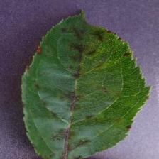
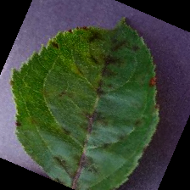
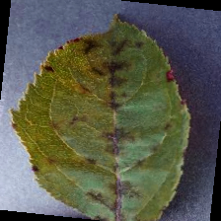
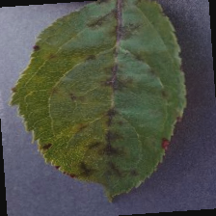
Datasets
Data source: Mendeley Data
Dataset link: https://data.mendeley.com/datasets/tywbtsjrjv/1
Total number of images: About 61486 images
Covered categories: 39 different classes of plant leaf and background images are available.
Data division: We divide the data into training set(70%), validation set(15%) and test set(15%).
Data augmentation methods: Expand the dataset using six image augmentation techniques(Image flipping,Rotation,Color augmentation...)
Presenter: Yi Ren (z5567992)
Notes:
For the dataset, we used a public dataset from Mendeley which contains over 61,000 images of 39 different classes of plant leaves, including healthy and diseased samples. We split the data into 70% training, 15% validation, and 15% test sets. We also applied various data augmentation techniques like flipping and rotation to improve model generalization.

Slide 6
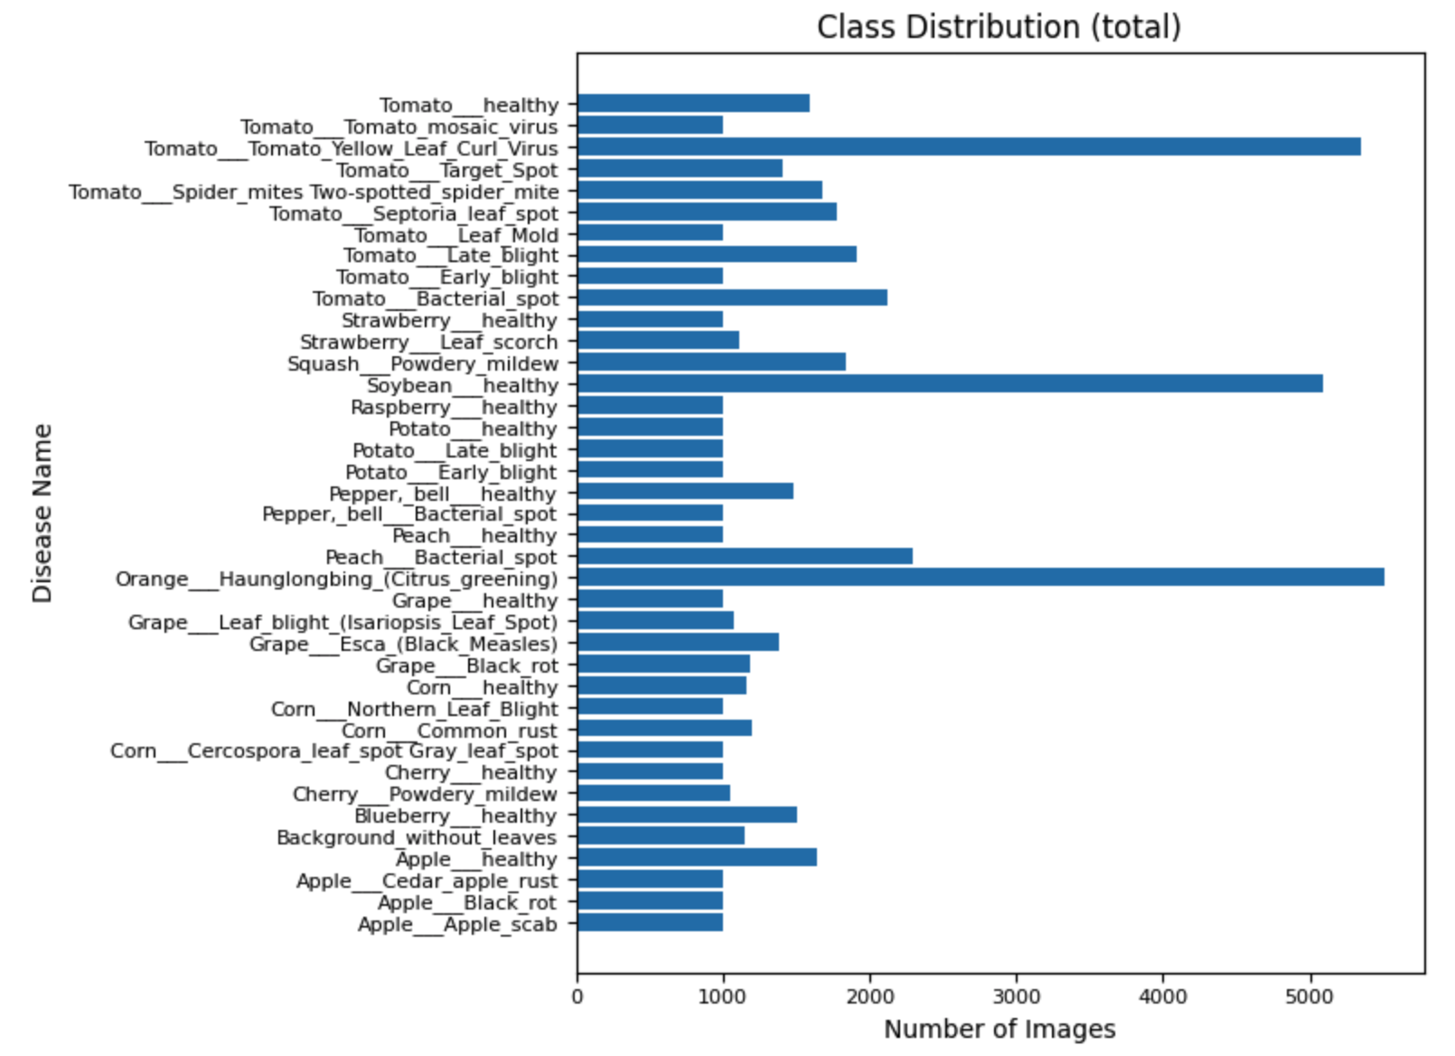
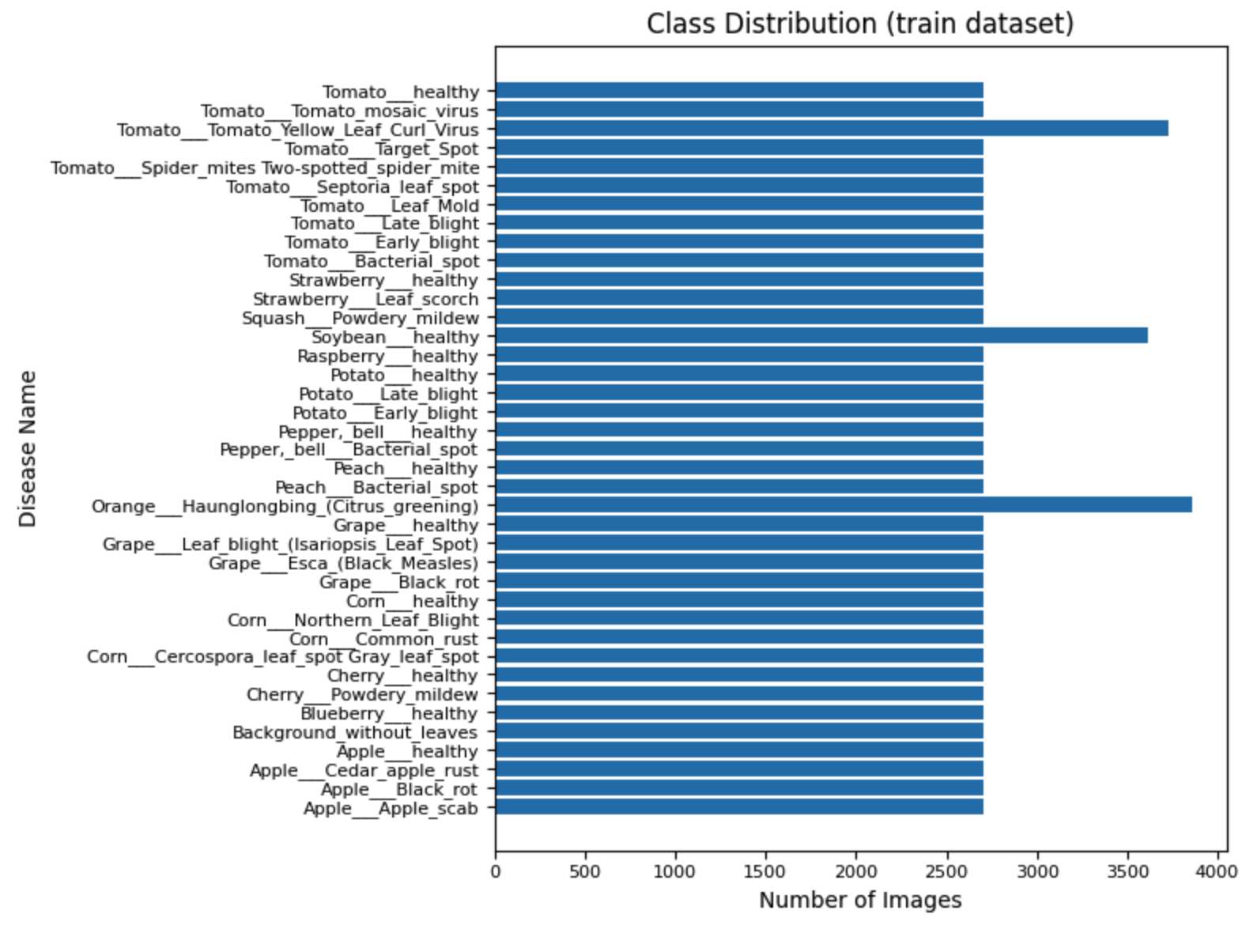
Data Analysis
The original dataset was imbalanced across classes. During preprocessing, minority classes were augmented until they reached 70% of the size of the largest class in the training set.
Presenter: Yi Ren (z5567992)
Notes:
Finally, in data analysis, we noticed the dataset was imbalanced—some classes had way fewer images. To address this, we oversampled the minority classes so that each had at least 70% of the largest class size in the training set.

Slide 7
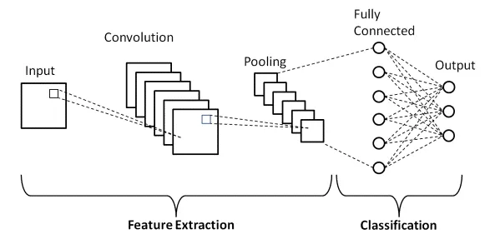
Method(8-layer-CNN)
Model structure:
Presenter: Haoyu Guo (z5568296)
Notes:
The first image illustrates the architecture of Convolutional Neural Network. The model performs feature extraction through convolution and pooling layers, followed by classification using fully connected layers. As a relatively simple model, we selected it as our baseline.
We designed an 8-layer CNN for leaf disease classification. It consists of 6 convolutional layers and 2 fully connected layers. The model takes 224×224 RGB images as input and uses 3×3 convolution kernels with max pooling to extract features. A global average pooling layer reduces the output to 512×1×1, which is then flattened and passed through two fully connected layers with 128 units and number classes units.
As our baseline model, this architecture strikes a good balance between accuracy and efficiency, making it suitable for plant disease detection tasks.

Slide 8
Method(8-layer-CNN)
Features
Model Simplicity & Interpretability:
This 8-layer CNN has fewer parameters, making it easier to interpret and debug. Its simplicity also allows for faster training and lower hardware requirements, making it ideal for lightweight deployment.
Fast Inference Speed:
The small size and shallow depth of the network allow for fast inference, making it suitable for real-time applications.
Robustness to Overfitting:
The use of GAP and fewer dense layers helps control overfitting, especially in datasets with class imbalance or noisy labels.
Presenter: Haoyu Guo (z5568296)
Notes:
This 8-layer CNN offers several practical advantages beyond its basic architecture. Its simplicity and low parameter count make it easier to interpret, debug, and train efficiently, even on low-end hardware — making it ideal for lightweight deployment. The small size and shallow depth contribute to fast inference speed, enabling real-time use in practical applications. Additionally, by using global average pooling and a compact fully connected head, the model shows strong robustness to overfitting, particularly when dealing with imbalanced or noisy datasets.

Slide 9
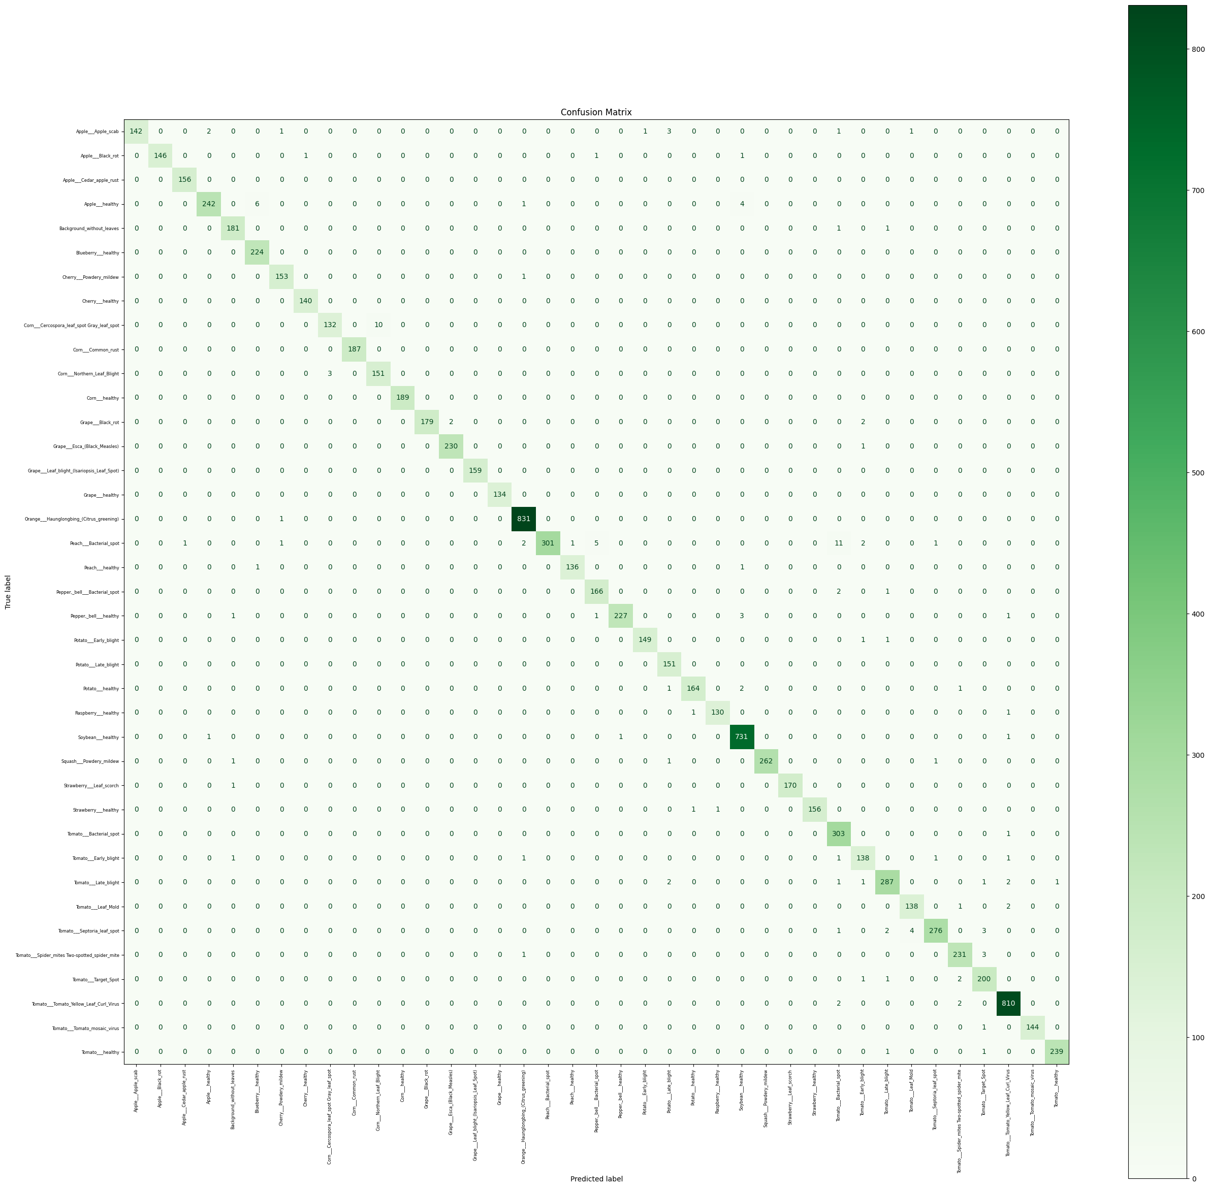
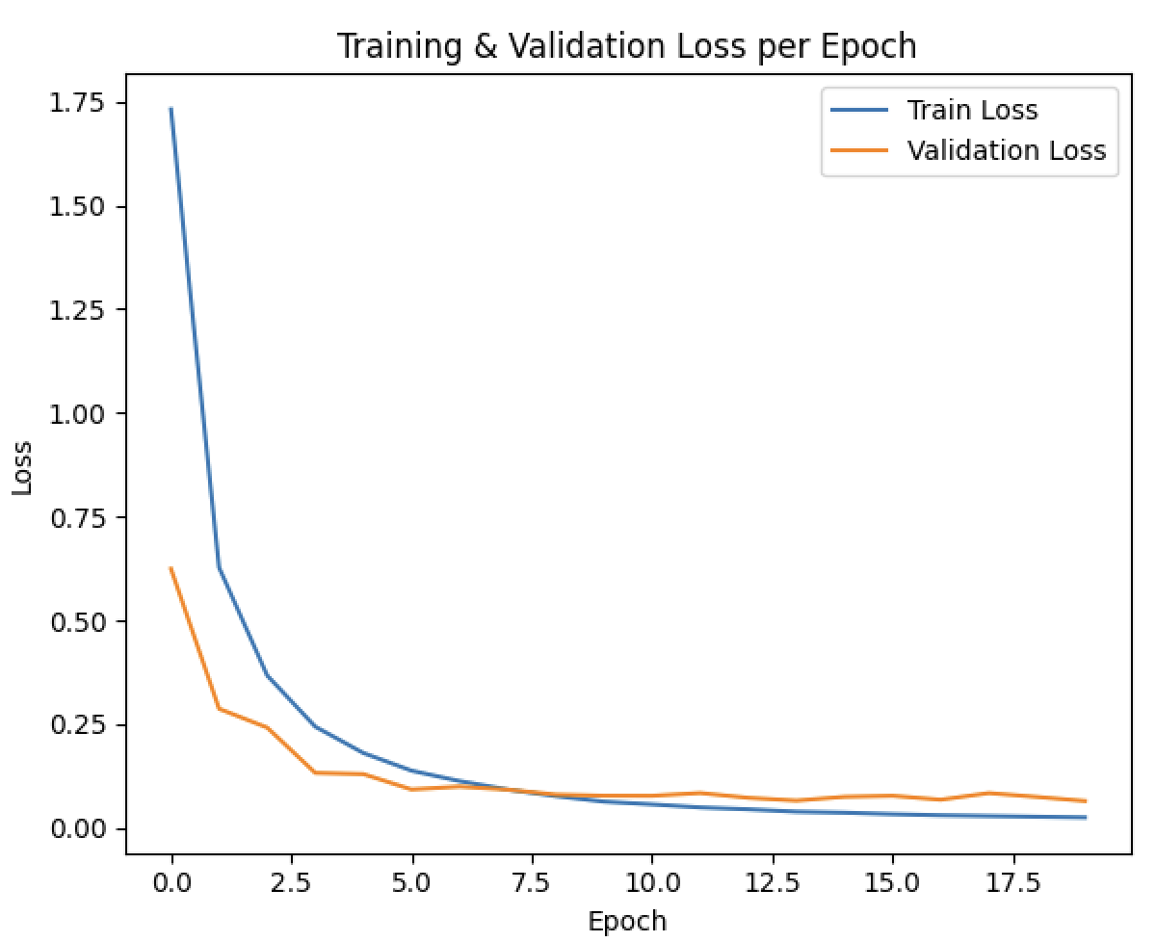
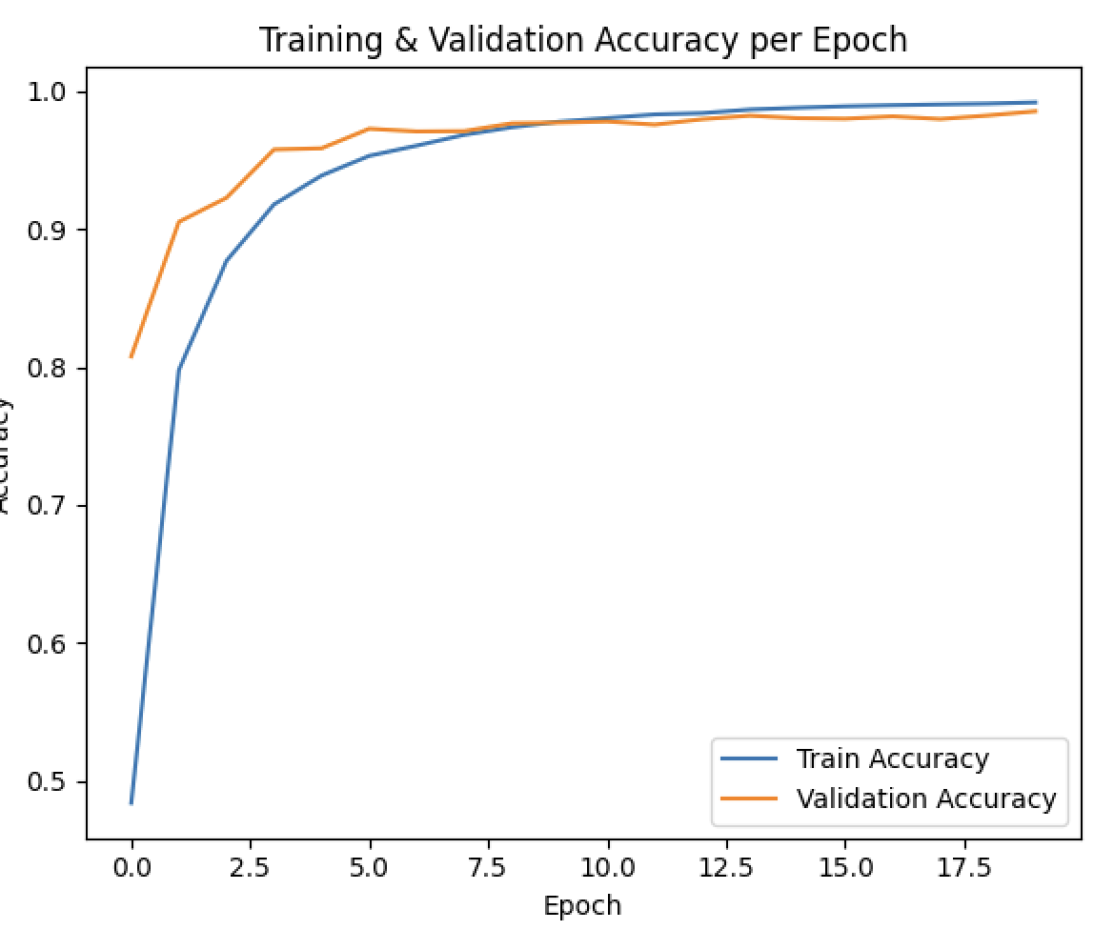
Method(8-layer-CNN)
Result:
Presenter: Haoyu Guo (z5568296)
Notes:
Here are three figures showing our model’s loss, accuracy, and confusion matrix.
8-layer CNN serves as a strong baseline, achieving 97.5% test accuracy with a simple and efficient architecture.

Slide 10
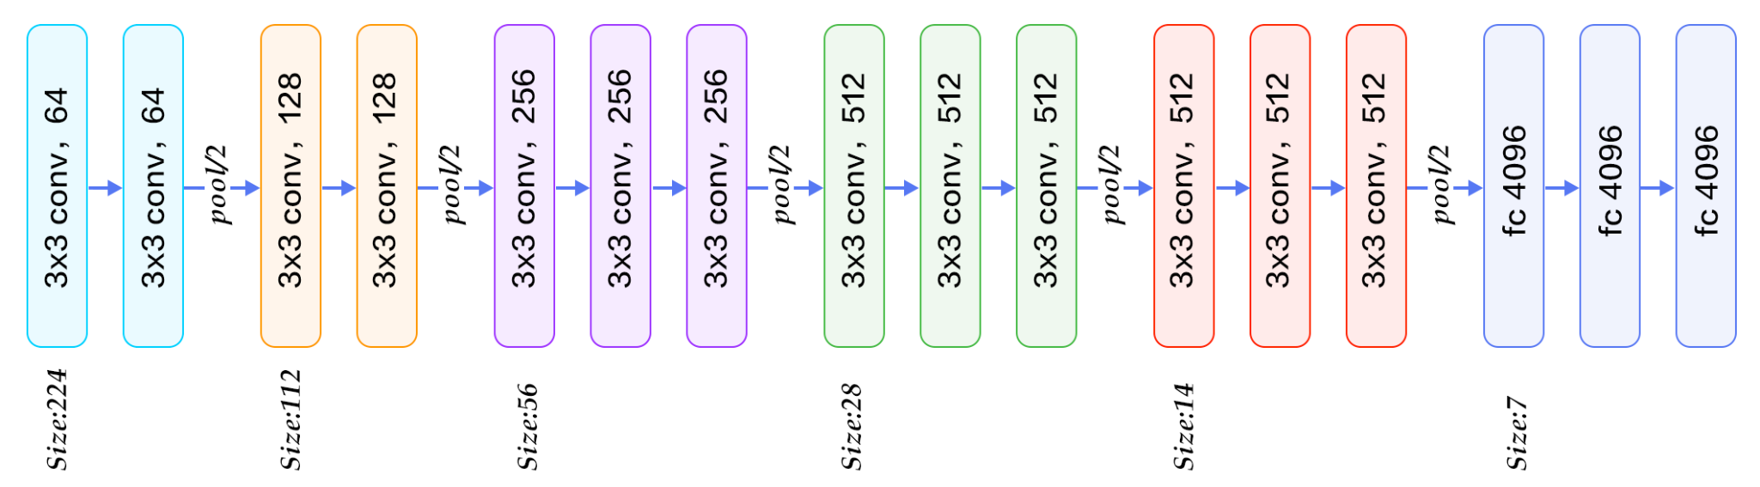
Method(VGG-16)
Model structure:
Presenter: Yi Chen (z5567828)
Notes:
VGG16 is a classic deep convolutional neural network architecture proposed in 2014. The model consists of 16 weight layers (13 convolutional layers and 3 fully connected layers). Its core design principle is to stack a large number of small (3×3) convolution filters with stride 2 to increase network depth and enhance the feature representation capacity.

Slide 11
Method(VGG-16)
Features:
Stacked small filters: Uses multiple 3×3 convolutions instead of larger filters, increasing depth and nonlinearities with fewer parameters.
Uniform architecture: All layers use 3×3 convolutions and 2×2 max pooling, making the design simple and consistent.
No bottleneck blocks: VGG16 stacks plain convolutions, while ResNet50 uses 1×1 and 3×3 bottleneck structures for efficiency.
Presenter: Yi Chen (z5567828)
Notes:
•Stacked small filters: Uses multiple 3×3 convolutions instead of larger filters, increasing depth and nonlinearities with fewer parameters.
•Uniform architecture: All layers use 3×3 convolutions and 2×2 max pooling, making the design simple and consistent.
•No bottleneck blocks: VGG16 stacks plain convolutions, while ResNet50 uses 1×1 and 3×3 bottleneck structures for efficiency.
The vanishing gradient problem means that, as gradients are backpropagated through many layers, they can become extremely small. This causes the early layers to learn very slowly, or not at all, limiting the ability of the network to learn from data.
The exploding gradient problem is the opposite: gradients become too large, which can make training unstable and cause the model parameters to diverge

Slide 12
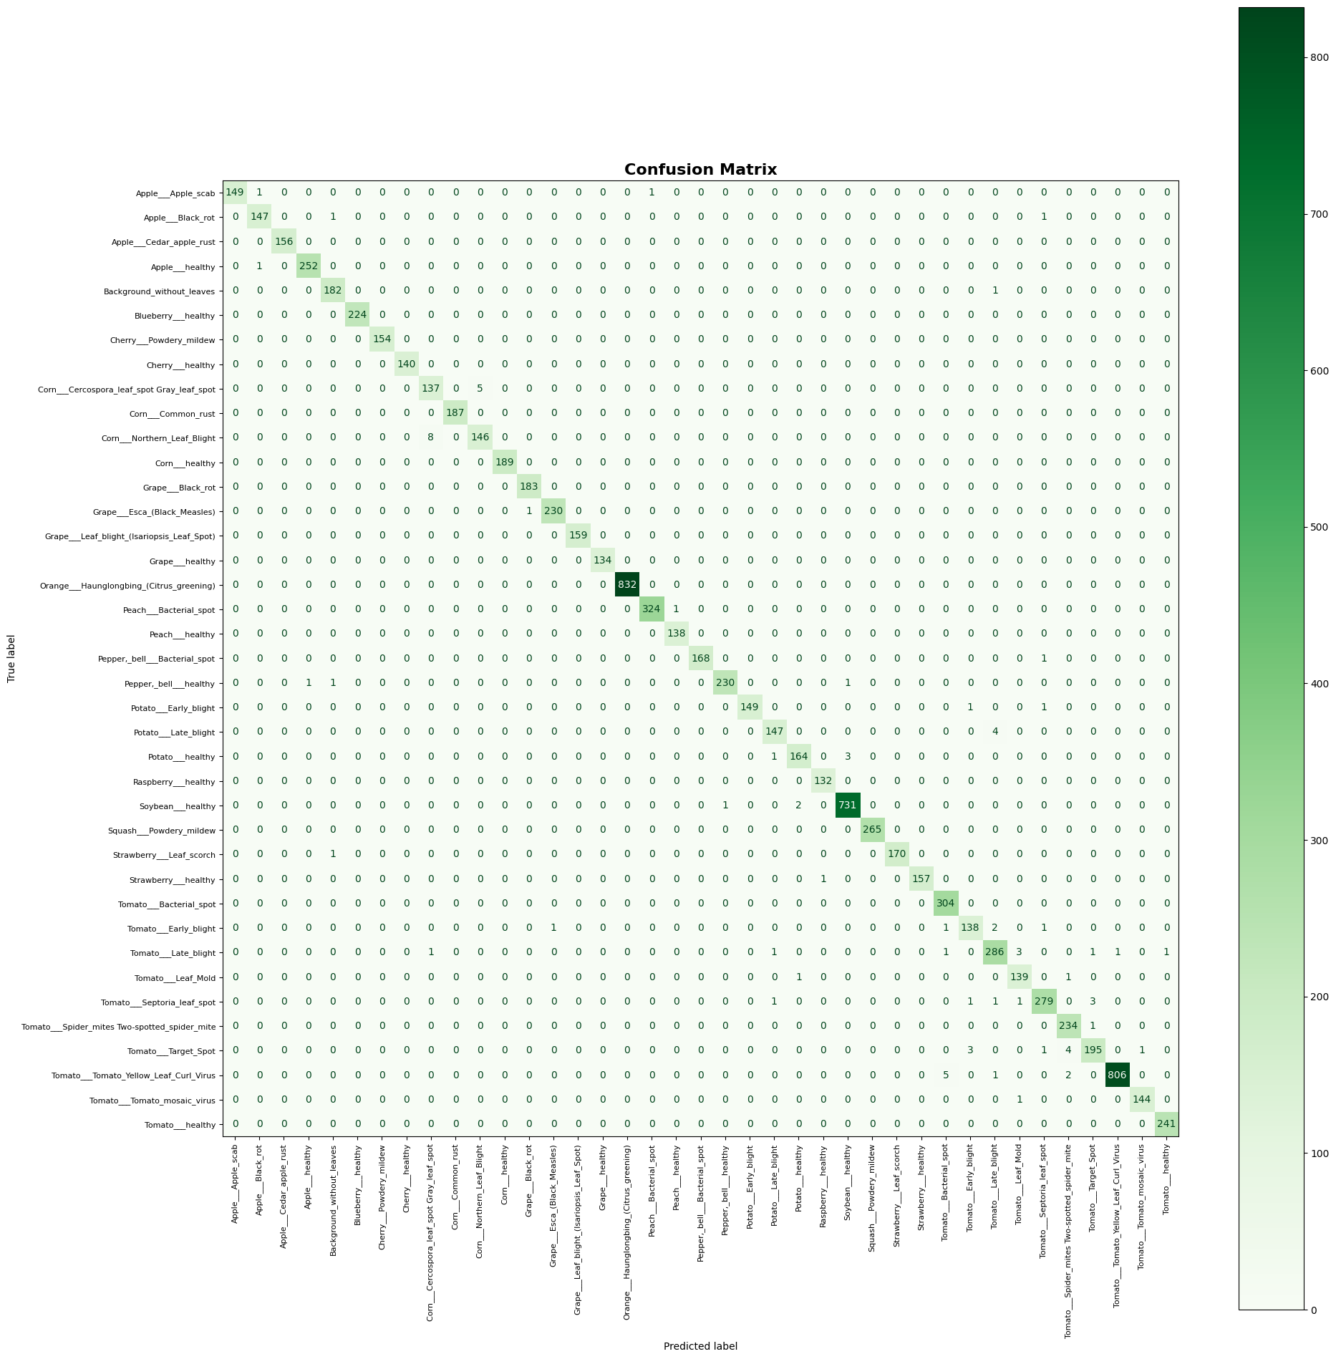
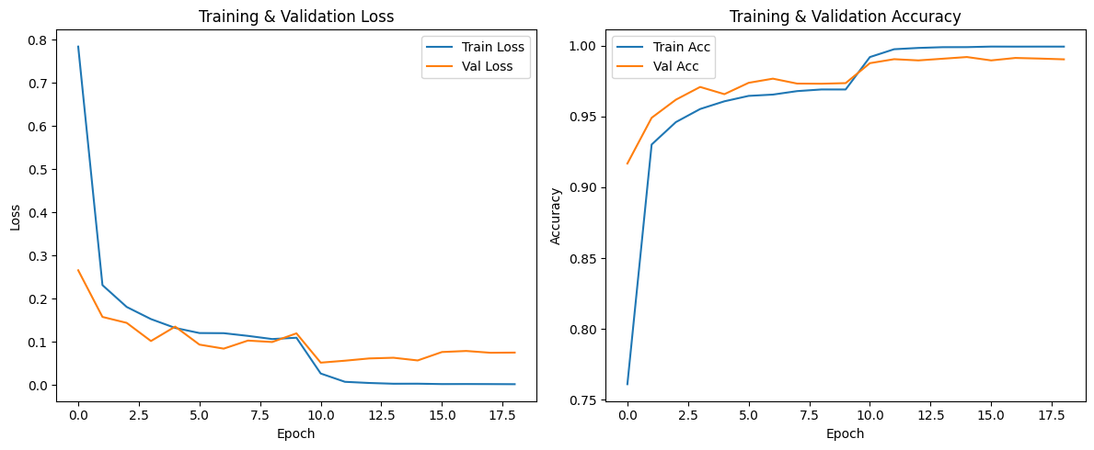
Method(VGG-16)
Result:
Presenter: Yi Chen (z5567828)
Notes:
Train and Validation Accuracy Trends：
From the first epoch, both training and validation accuracy improve rapidly, with training accuracy rising from 0.76 to nearly 1.0, and validation accuracy from 0.92 to about 0.99. This demonstrates the model’s strong learning capacity.
After epoch 10, the training accuracy reaches almost 100%, indicating the model has almost perfectly memorized the training data.
The validation accuracy remains very high after epoch 10 (between 98.7% and 99.2%), and the validation loss is also low, with no drastic overfitting observed.
However, the training loss becomes extremely low (close to 0), and the validation loss starts to show minor fluctuations, suggesting the model’s generalization is already near its limit, with little we can do for further improvement. Which shows a mild overfitting.
When it comes to conf metrix. We find The model is very strong at distinguishing almost all disease and healthy leaf categories. Many classes have virtually no errors, indicating exceptional model capability but still some misclassified in datasets process with our model. Apple___Apple_scab & Cherry___healthy with 1 sample misclassified as Background_without_leaves. Because the number of misclassified samples is very small. I suppose it might due to Poor Image Quality or Ambiguous Content

Slide 13
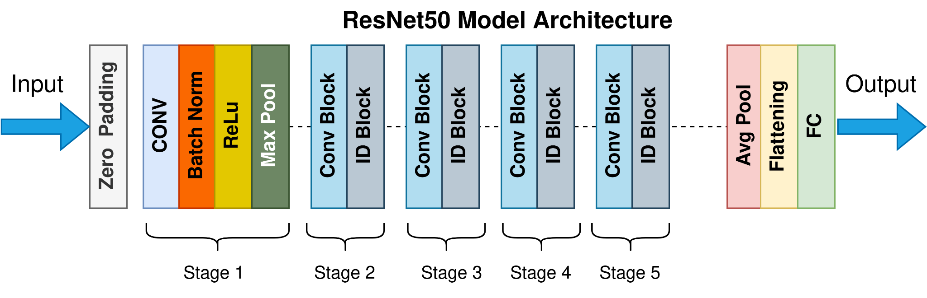
Method(Resnet50)
Model structure:
50-layer deep convolutional neural network based on the concept of residual learning.
Presenter: Dongbin Pu(z5580978)

Slide 14
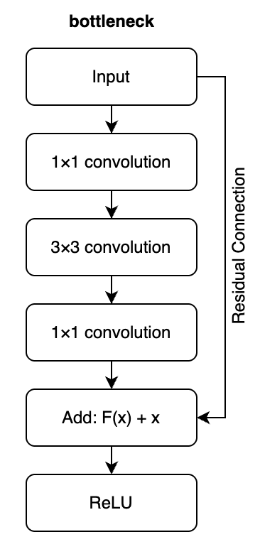
Method(Resnet50)
Features
Bottleneck Architecture: 1×1 convolution for dimension reduction + 3×3 convolution + 1×1 convolution for restoration, improving computation efficiency.
Skip connection/Residual Connection: to alleviate the vanishing/exploding gradient problems in deep networks.
Presenter: Dongbin Pu(z5580978)

Slide 15
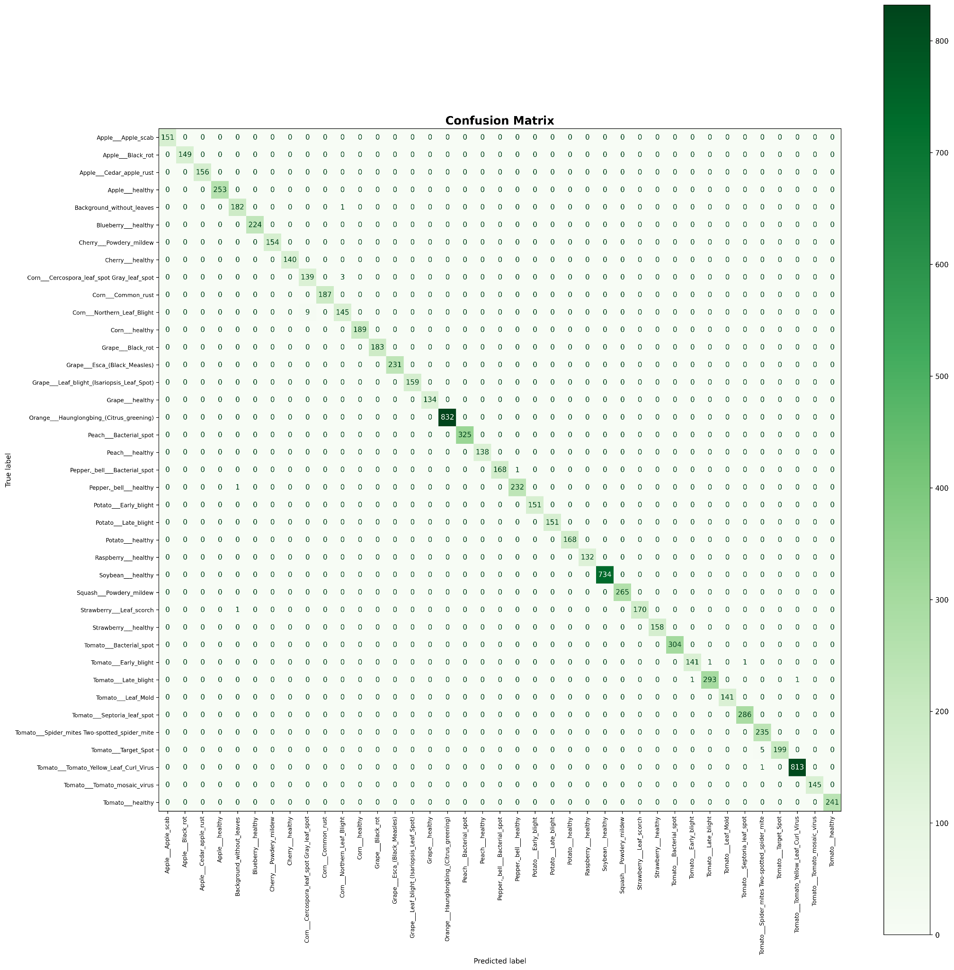
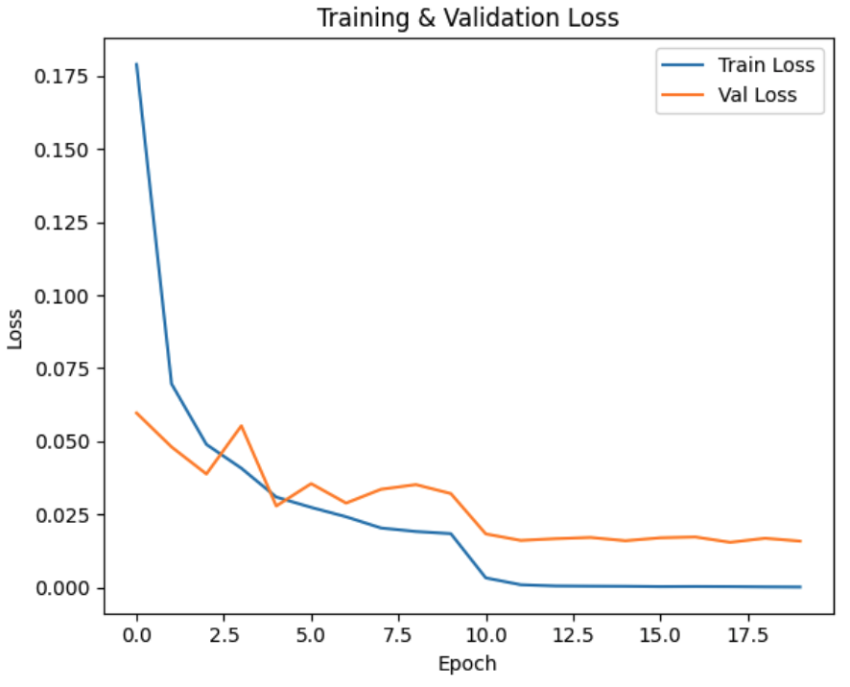
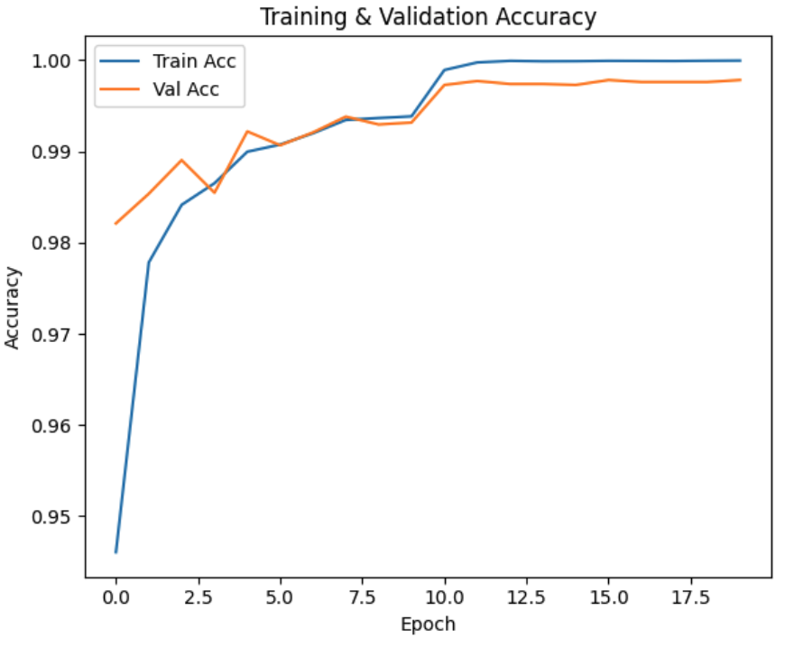
Method(Resnet50)
Results
Presenter: Dongbin Pu(z5580978)

Slide 16
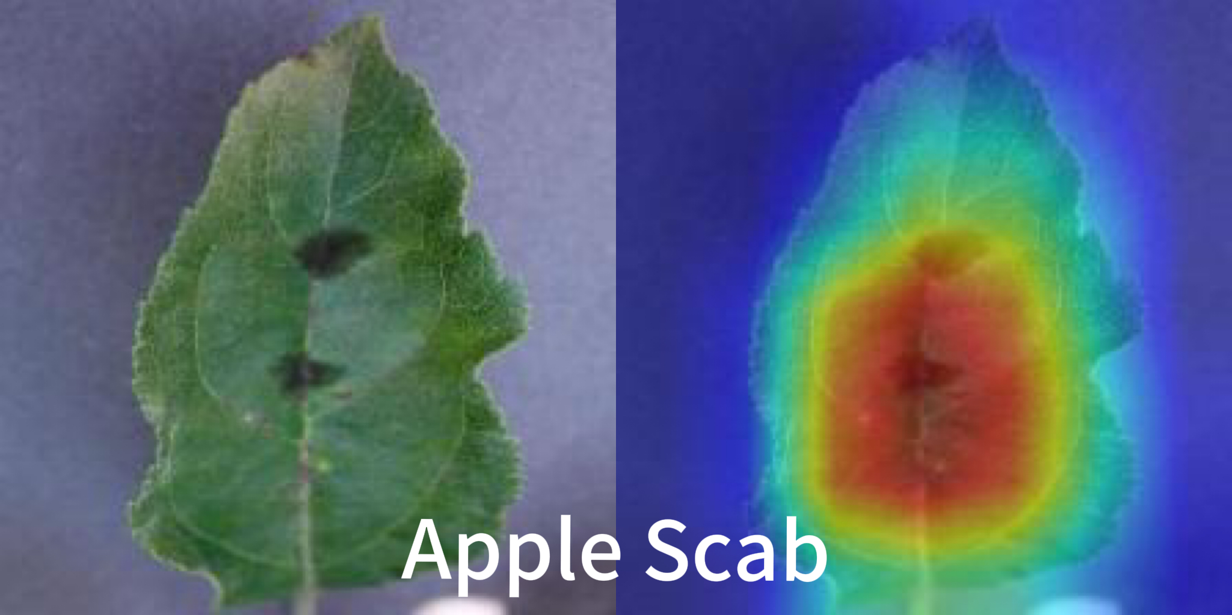
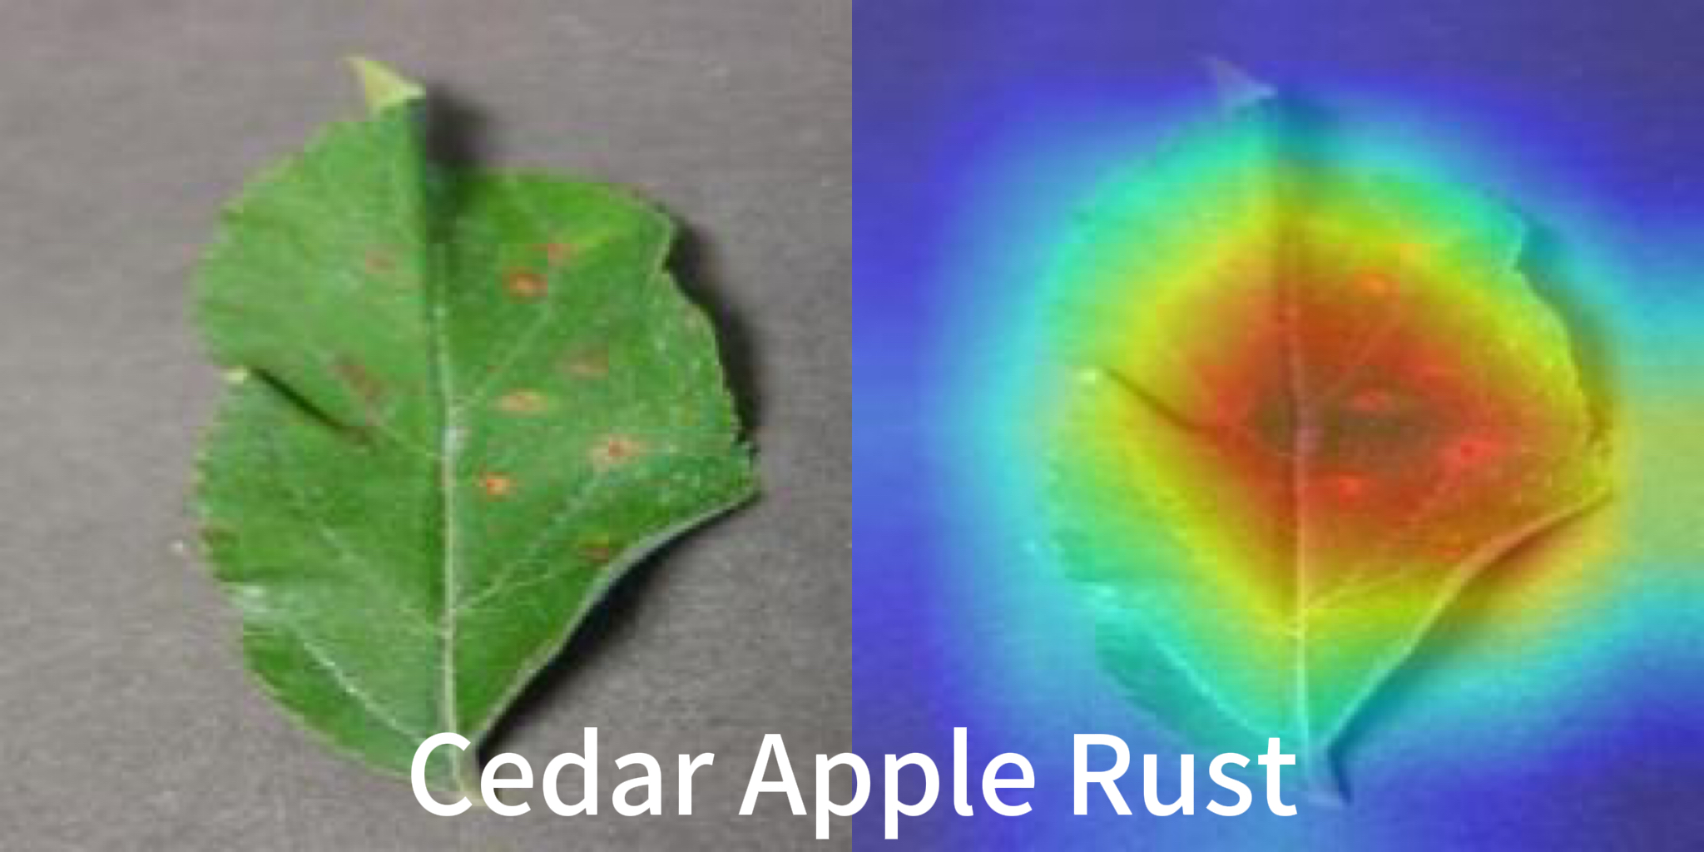
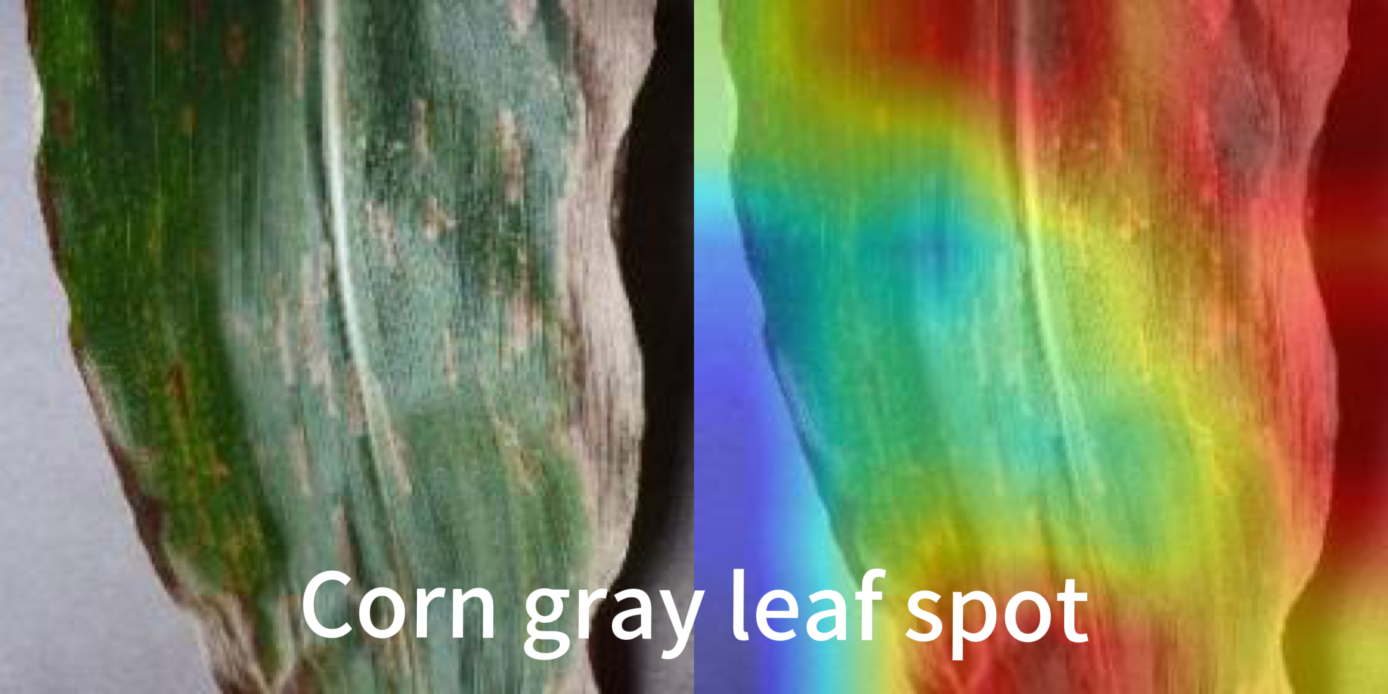
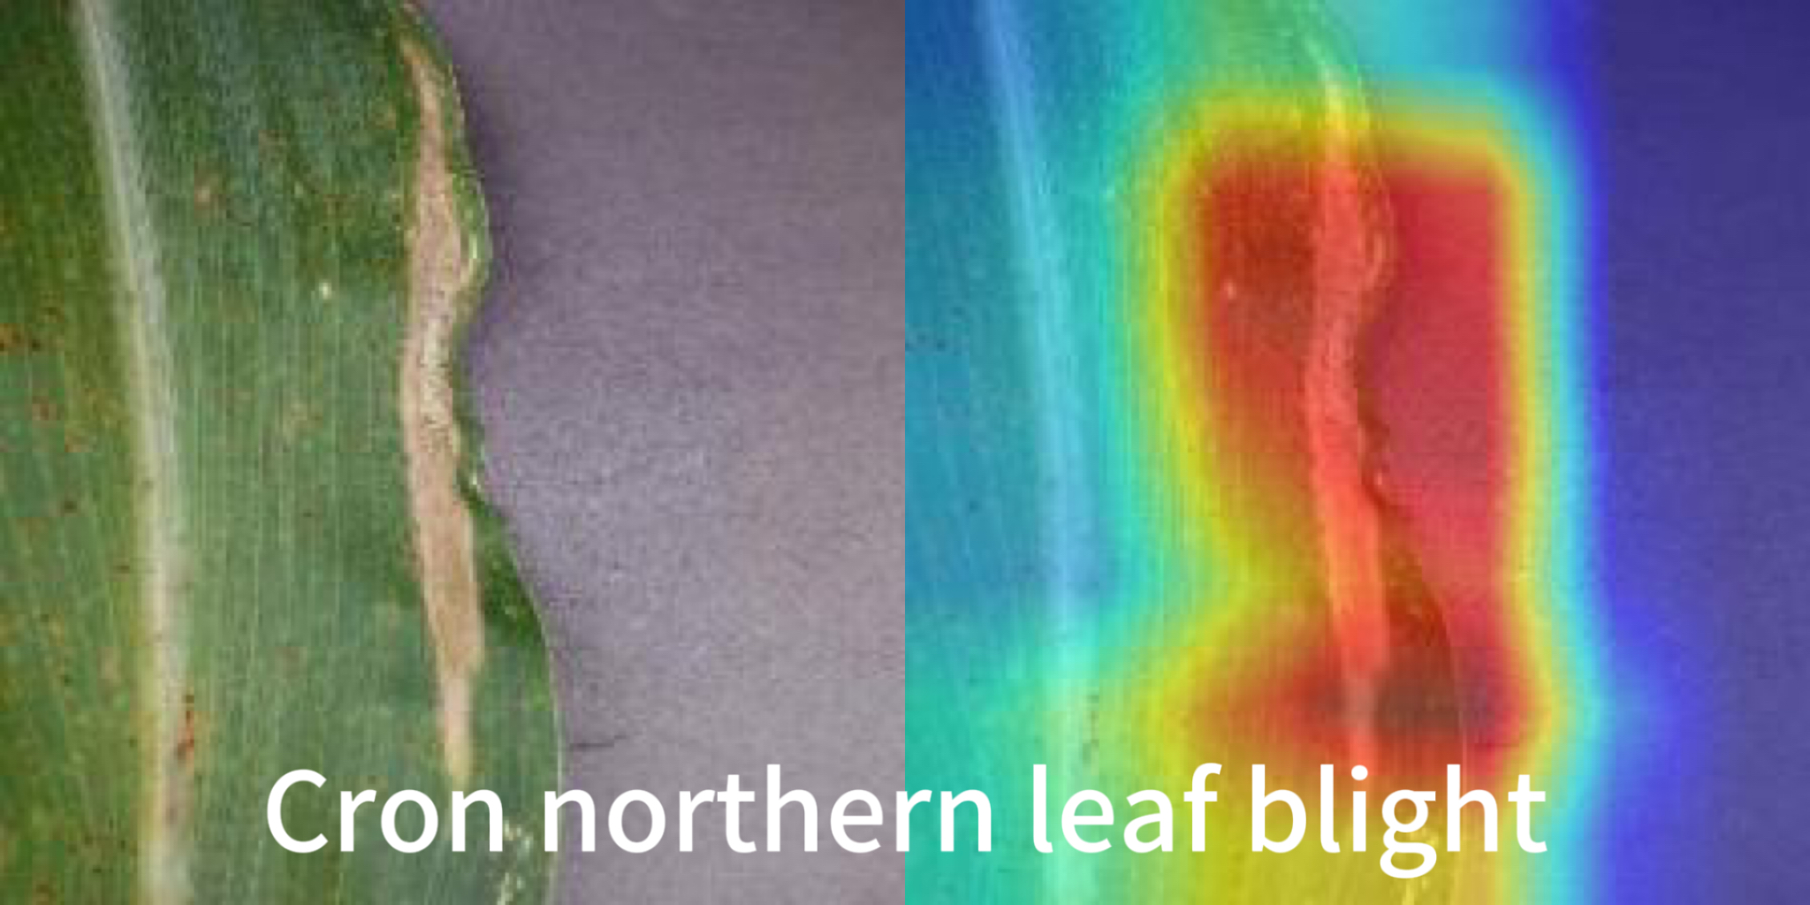
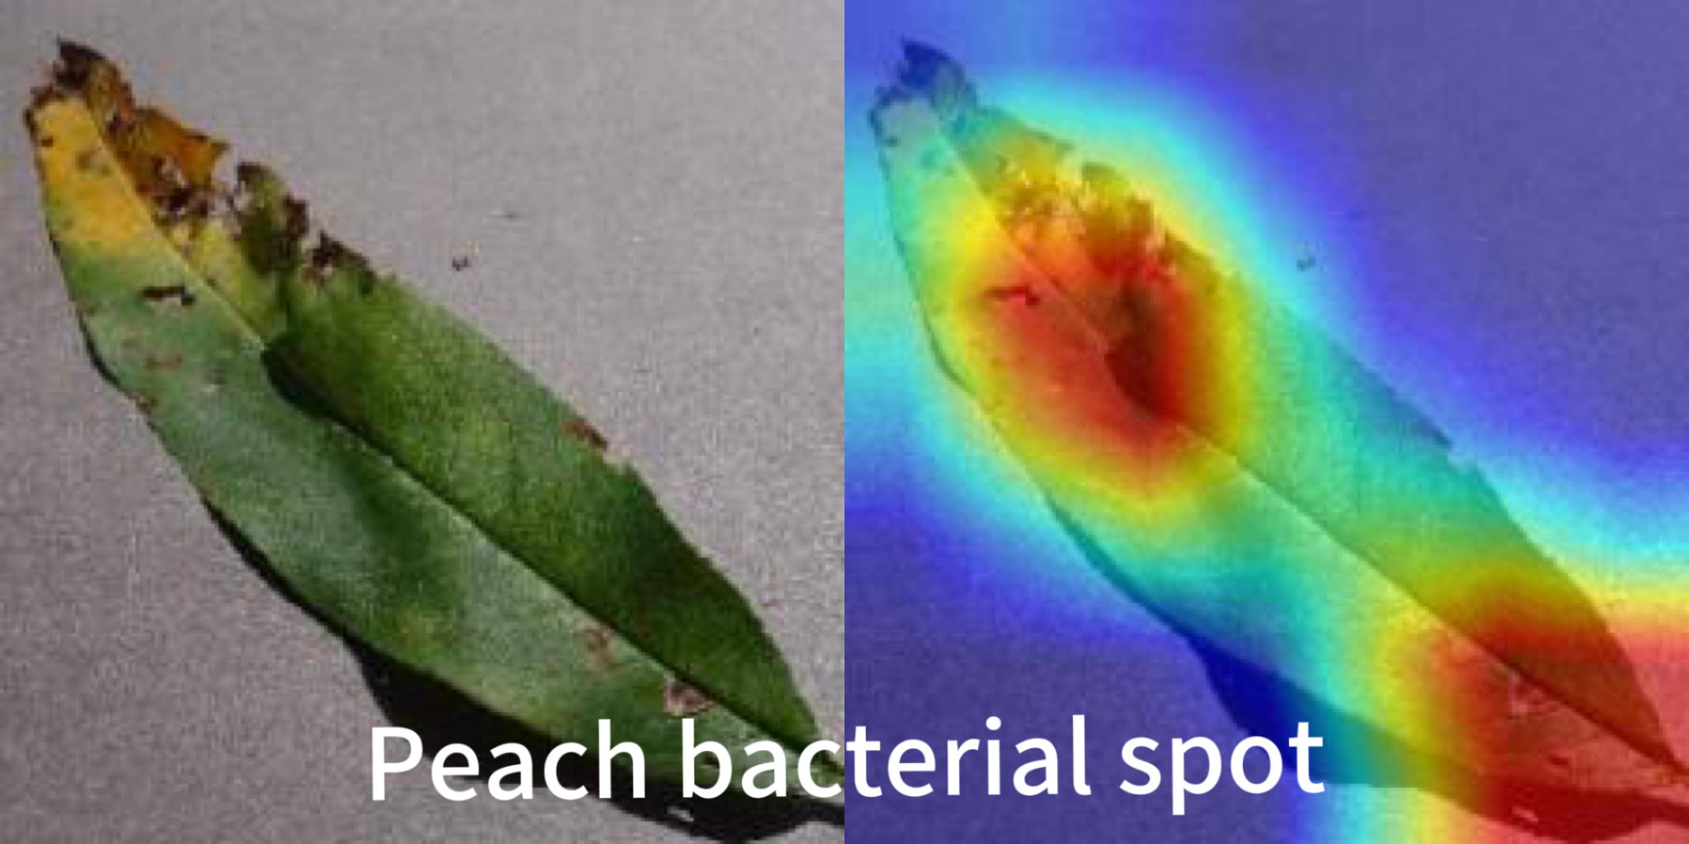
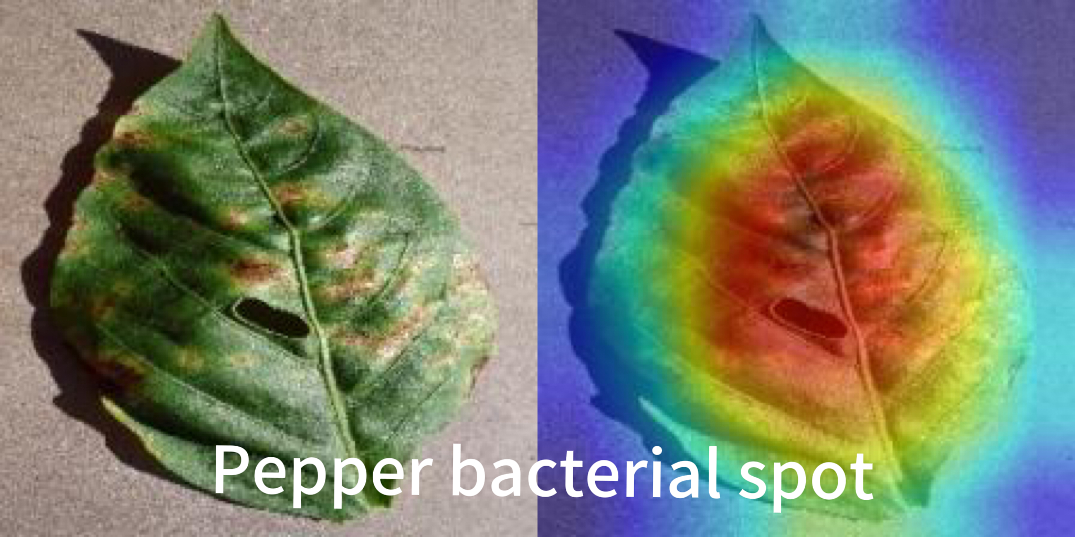
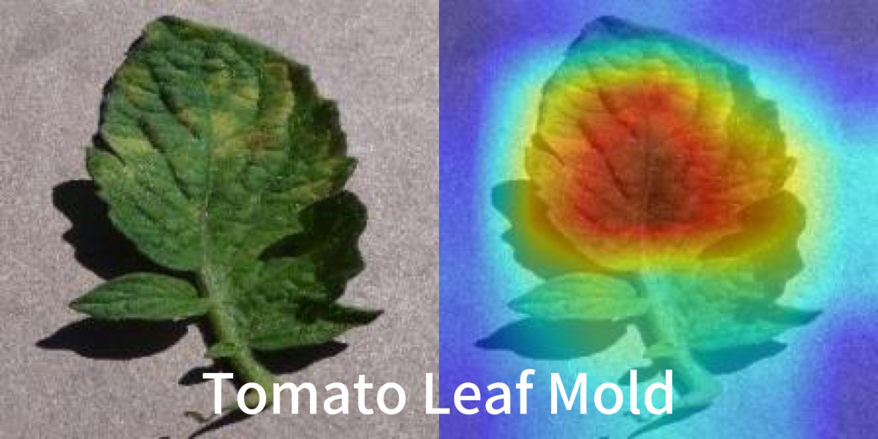
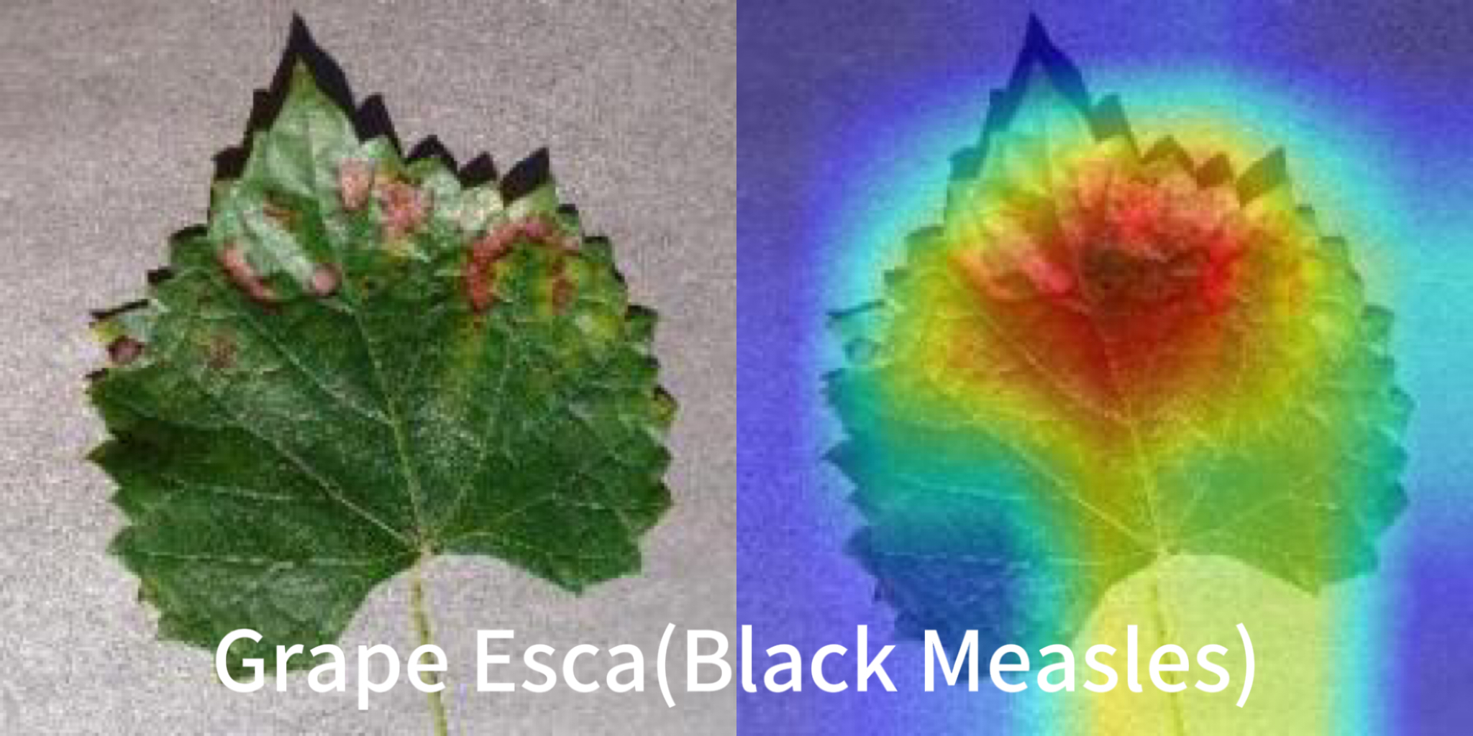
Results visualisation (Grad-CAM)
Grad-CAM visualizes important image regions for classification.
Uses gradients from the last conv layer to create a heatmap over the input image.
ResNet50
Presenter: Dongbin Pu(z5580978)

Slide 17
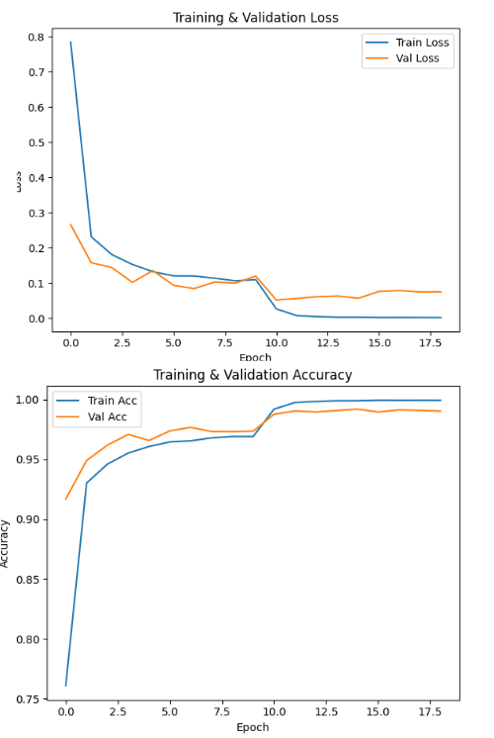
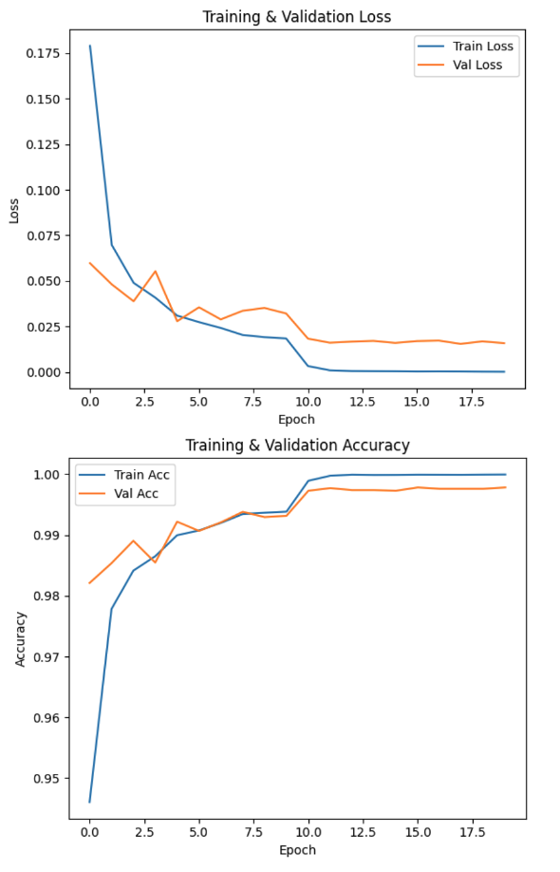
Discussion
Training Performance Comparison
8-layer CNN serves as a strong baseline, achieving 98.5% test accuracy with a simple and efficient architecture.
VGG-16 also performs very well (~99% validation accuracy), but slightly less consistent than ResNet50.
ResNet50 achieves nearly 99.8% training and 99.7% validation accuracy, with minimal overfitting.
8-layer-CNN
VGG-16
Resnet50
Presenter: Yixiao Wang (z5519041)

Slide 18
Discussion
8-layer CNN performs well, But makes a few more mistakes on similar or rare classes.
VGG-16 shows good performance too, but with a few more errors — especially for certain similar or low-sample classes.
ResNet50’s predictions are highly concentrated on the diagonal — meaning almost all classes were predicted correctly.
Confusion Matrix Comparison
8-layer-CNN
VGG-16
Resnet50
Presenter: Yixiao Wang (z5519041)

Slide 19
Discussion
Evaluation metrics Comparison
Method | 8-Layer-CNN | VGG16 | ResNet50
Test Acc | 0.9849 | 0.9900 | 0.9971
Precision | 0.9852 | 0.9901 | 0.9971
Recall | 0.9849 | 0.9900 | 0.9971
F1 Score | 0.9849 | 0.9900 | 0.9971
Presenter: Yixiao Wang (z5519041)

Slide 20
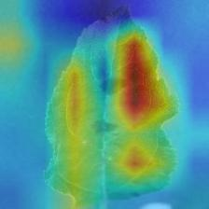
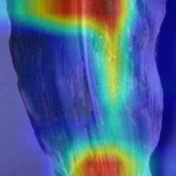
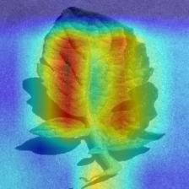
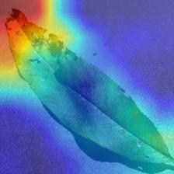
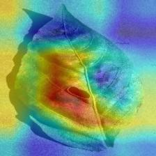
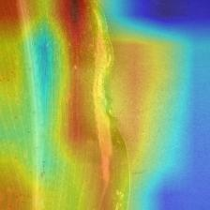
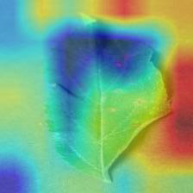
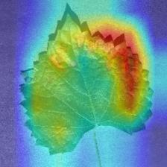
Discussion
Improvements of ResNet50 over 8-layer CNN
Original ResNet 8-layer CNN
Left group: CNN recognition error
Middle group: CNN recognized correctly
Right group: CNN recognition is unclear
In general, the ResNet model has better recognition — it captures leaf disease features more effectively than the other models.
Original ResNet 8-layer CNN
Original ResNet 8-layer CNN
Presenter: Yixiao Wang (z5519041)

Slide 21
Conclusion
Deeper networks (VGG16, ResNet50) can learn more complex features compared to shallow CNNs.
VGG16 improves accuracy but is prone to vanishing/exploding gradients when depth increases.
ResNet50 uses residual connections to effectively avoid gradient vanishing, enabling very deep architectures to train well.
Deeper is not always better — requires good design to ensure stable training.
Presenter: Yixiao Wang (z5519041)

Slide 22

Thank you for listening! Any Questions?
This Photo by Unknown Author is licensed under CC BY-SA

